Slide 1
INTRODUCTION TO INTELLECTUAL PROPERTY RIGHTS

Slide 2
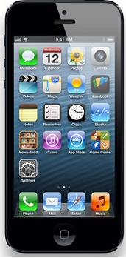

Intellectual Property?
TRADEMARK (MARKA)
PATENT
COPYRIGHT (TELİF HAKLARI)
TASARIM (DESIGN)
TRADE SECRET (TİCARİ SIR)
VS.

Slide 3
IP RIGHTS
RIGHTS ON LITERARY AND ARTISTIC WORKS
INDUSTRIAL PROPERTY RIGHTS
COPYRIGHT
RELATED RIGHTS
PATENT
UTILITY MODEL
DESIGN
TRADE SECRETS
TRADE NAMES
TRADE MARKS
COMMERCIAL TITLES
DOMAIN NAMES
GEOGRAPHICAL INDICATIONS

Slide 4
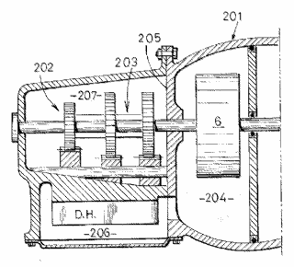


The different types of IP (I)
Legal right
What for?
How?
Patents
New inventions
Application, examination and registration
Utility models
New inventions
Application, examination and registration
Copyright
Original creative or artistic forms
Exists automatically
4
Notes:
4

Slide 5



The different types of IP (II)
Legal right
What for?
How?
Trade marks
Distinctive identification of products or services
Registration or use
Registered designs
Registered designs
Designs
External appearance
External appearance
External appearance
Registration or use
Trade secrets
Valuable information not known to the public
Reasonable efforts to keep secret
Intellectual Property - Law
5
Notes:
5

Slide 6
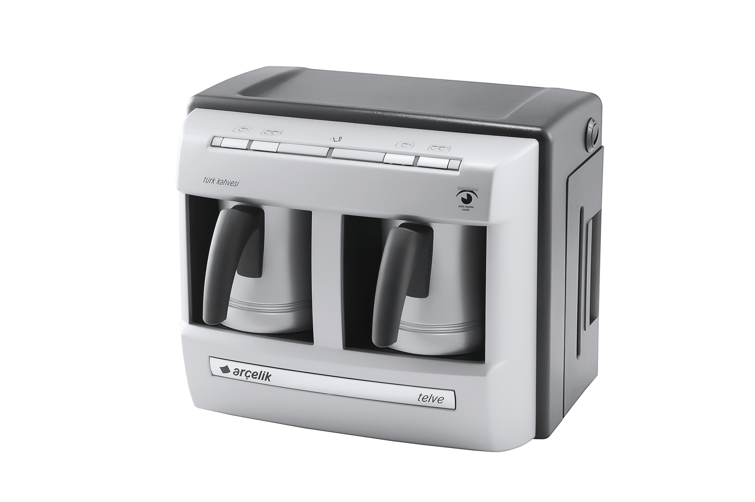
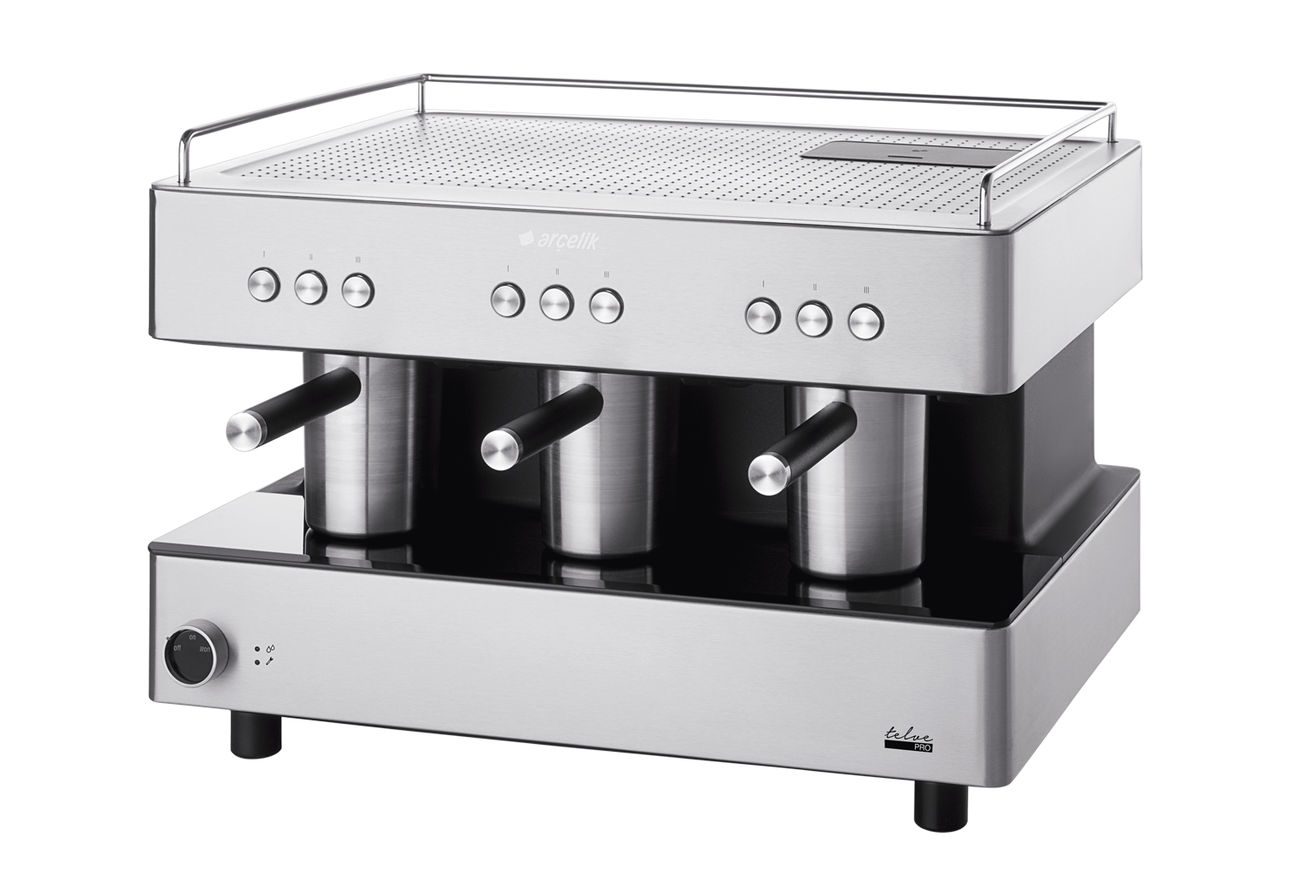
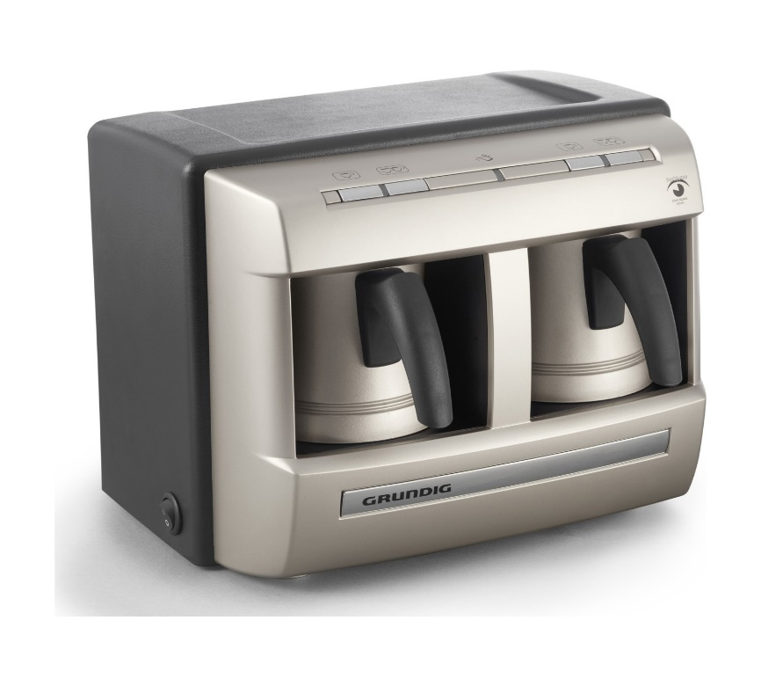

Slide 7


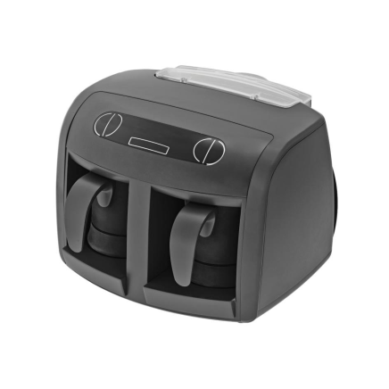
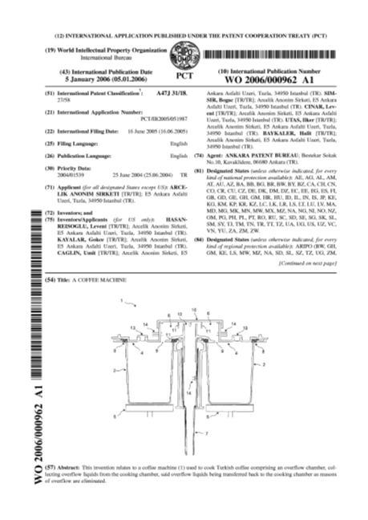

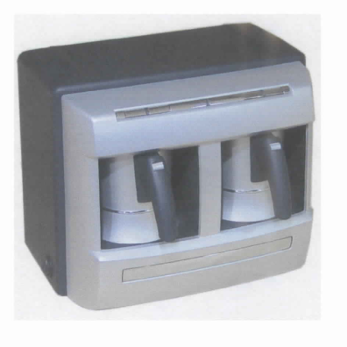

Slide 8
How to Utilize IP Rights
Prevent others from making
Use as bargaining chip
License out- license in

Slide 9
Common Features of IPR’s
Abstract nature (Soyut nitelik)
Novelty (Yenilik)
Exclusivity (Engelleme hakkı)
Registration (Tescil)
Territoriality (Ülkesellik)
Exhaustion/First Sale (Tükenme)
Term (Süreye tabi olma)

Slide 10
Abstract Nature
IPR’s are not tangible
A person who owns the tangible property does not have to be (and usually isn’t) the owner of the IPR
Eg.:
A person who bought a smart phone has only the right to use the software on agreed terms
When you pay for and download music from the internet you cannot distribute the copies to your friends

Slide 11
Novelty
IPR’s are granted in exchange of new ideas shared with the society
The nature of novelty may differ according to the various forms of IPR’s
Novelty + Inventive step (Patents)
Novelty (Utility models)
Novelty + Individual character (Designs)
Originality (Copyrights)
Distinctiveness (Trademarks)

Slide 12


Right to Exclude
Actions which may be prevented:
Manufacture
Sale
Importation
Use
Possession
Right to exclude does not necessarily mean right to make!!!!!!!!!

Slide 13
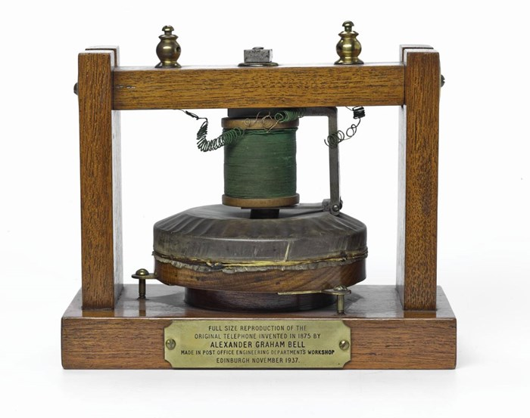
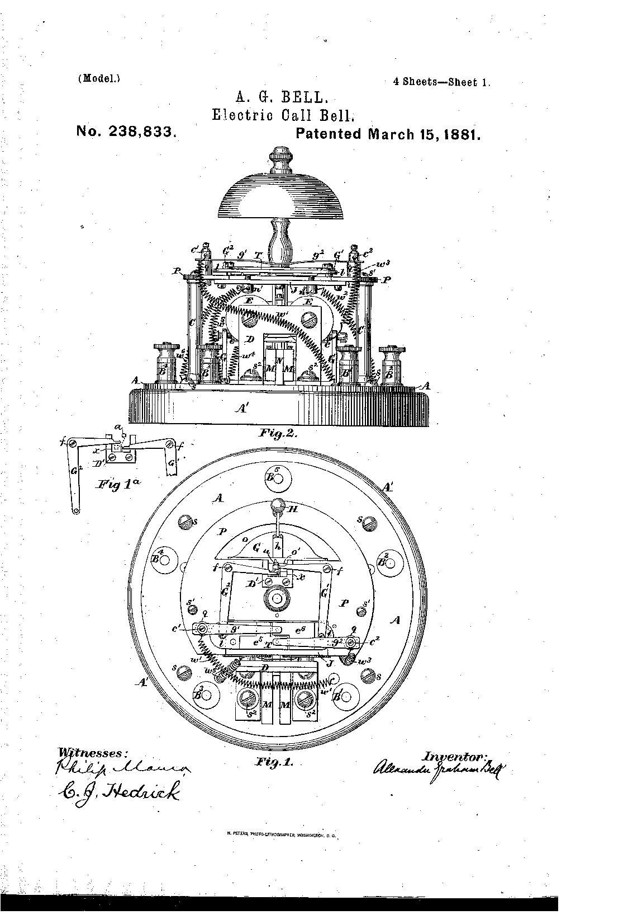
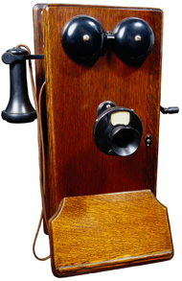
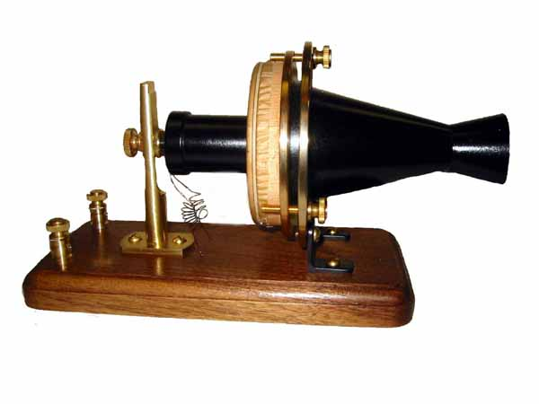

Slide 14
Registration
Registration is required for the protection of IPR’s
Exceptions:
Copyright,
Unregistered trademarks and designs ( by unfair competition)
Trade secrets
Protection and term starts beginning from the application, not registration

Slide 15
Territoriality
IPR’s are territorial
To acquire IP right in a country, the IP right must be registered in that country
Conditions of protection is evaluated by the country for which the registration is sought
International efforts for stretching the principle of territoriality
1886 Bern Convention (copyrights) 176 member states
National treatment
Works shall be protected in all Bern Convention countries
1883 Paris Convention (industrial property rights) 177 member states
Priority right
National treatment
1995 TRIPS Agreement-167 member states
International agreements regulating common application
Single international application run by WIPO
Different agreements for different IP forms
Patents-PCT – 152 countries
Trademarks-Madrid – 101 countries
Designs- Hague (Lahey) – 69 countries
Examination run by each country according to its own domestic law
Single common examination system for patents
EPO-EPC – 38 countries
Regional organizations and centralized registration
EU
Designs
Tardemarks
Unitary patent

Slide 16
Priority Right
The priority right allows the applicant to file a subsequent application in another country for the same invention, design, or trademark effective as of the date of filing the first application.
The period of priority, i.e., the period during which the priority right exists, is 6 months for industrial designs and trademarks and 12 months for patents and utility models

Slide 17
Exhaustion of IPR (First Sale)
Once a product protected by an IP right has been marketed with IPR owner’s consent, the IP rights of commercial exploitation over this given product can no longer be exercised by the IPR owner.
Exhaustion types and parallel imports:
National exhaustion
Regional exhaustion
International exhaustion
Right to repair
Repair or manufacture?

Slide 18
Term
IPR protection limited to a certain term.
Patents 20 years
Utility mod. 10 years
Designs 5x5 years
Trademarks 10 years with the opportunity to renew
Copyrights Life+70 years
At the end of the term the IPR falls in the public domain
Some IPR registrations may be renewed

